Slide 1
Photochemistry
1. Estimate the protection of the stratospheric ozone layer. Estimate the UV spectrum of sunlight at earth’s surface. [3/12交]
Chemical Reaction Kinetics
2. Estimate the global production rate of CH₄.
Thermal Dynamics
3. Estimate the thermal-dynamics-limit efficiencies of an air conditioner and a heat pump.
Quantum Mechanics
4. Estimate the tunneling current(? probability) of a scanning tunneling microscope.

Slide 2
What is an Air Conditioner?
What is its principle of operation?
Use GOOGLE
What is a Heat Pump?
What is its principle of operation?
Use GOOGLE

Slide 3

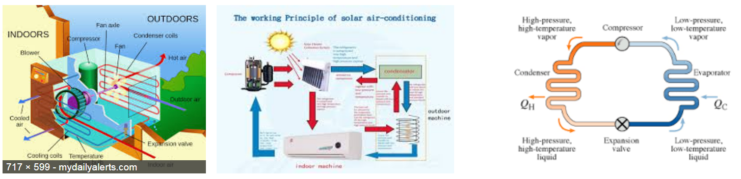
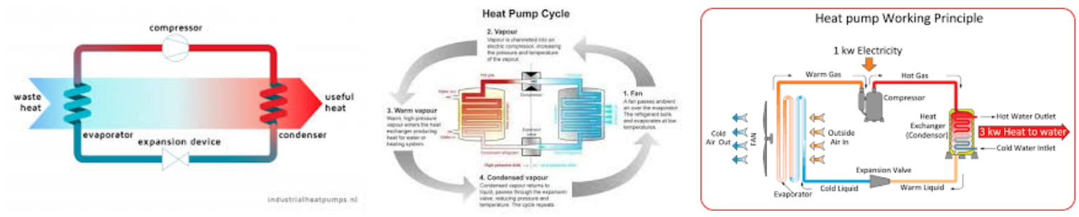

Slide 4
Q: Nowadays, Air Conditioners (AC) can reach rather high efficiencies. How close are they to the thermal dynamic limits?
The thermal dynamic limit of energy efficiency can be estimated with Carnot cycle.
But what temperatures should we use for the Carnot cycle?
To extract heat, the cold-end temperature of AC must be lower than the indoor temperature;
To release heat, the hot-end temperature of AC must be higher than the outdoor temperature. By ? degrees?

Slide 5
To simplify the situation, we may first fix the cold-end temperature to 5 degree C (278 K) and vary the hot-end temperature.
T_{H}−T_{L} T_{H} T_{L} T_{H}/T_{L} Eff_{Carnot}
10 288 278 1.04 27.8
15 293 278 1.05 18.5
20 298 278 1.07 13.9
25 303 278 1.09 11.1
30 308 278 1.11 9.3
35 313 278 1.13 7.9
40 318 278 1.14 7.0
45 323 278 1.16 6.2
50 328 278 1.18 5.6
55 333 278 1.20 5.1
60 338 278 1.22 4.6
65 343 278 1.23 4.3
70 348 278 1.25 4.0
75 353 278 1.27 3.7

Slide 6
How the real AC efficiency changes with the load?

Slide 7
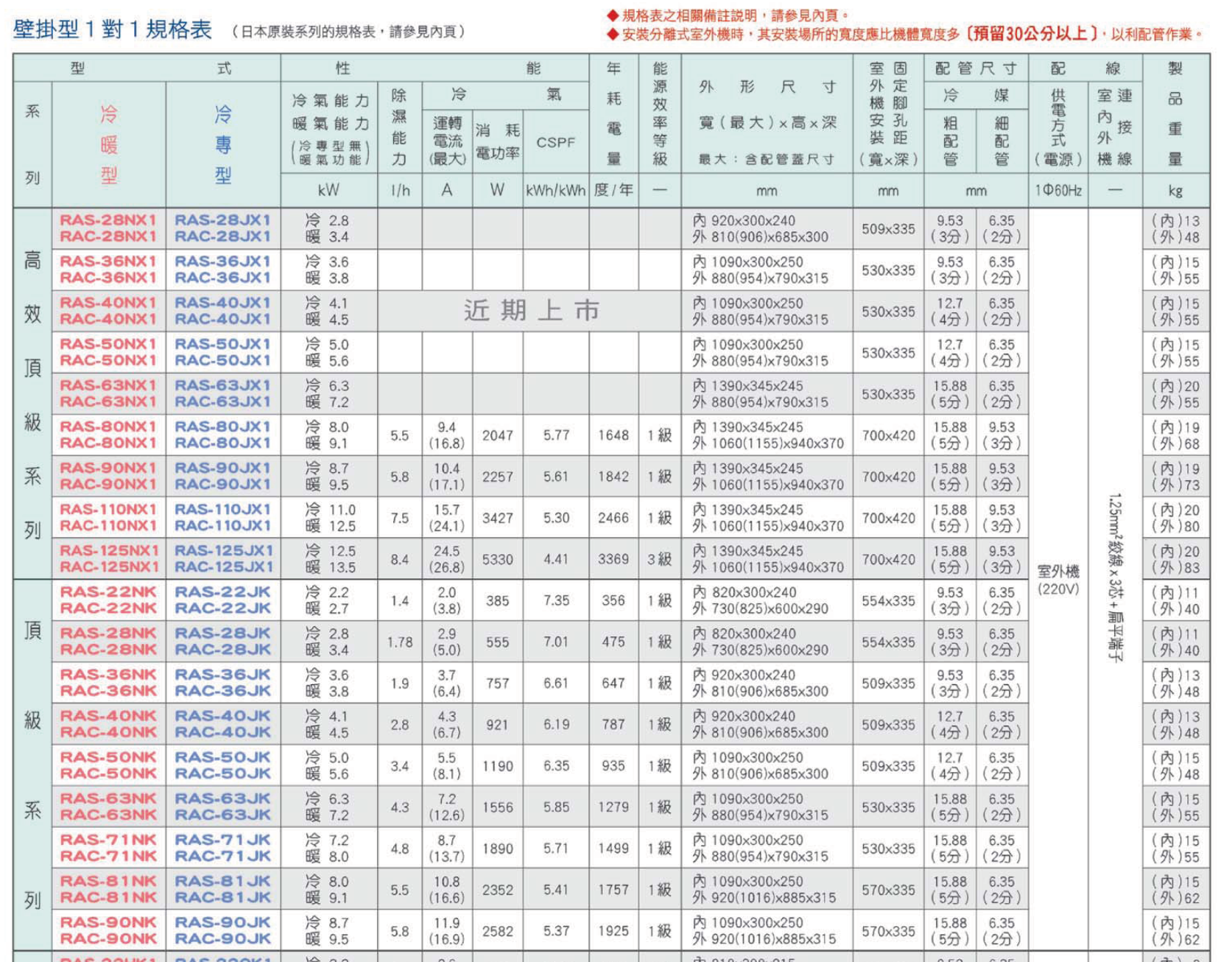
http://www.jci-hitachi.tw/

Slide 8
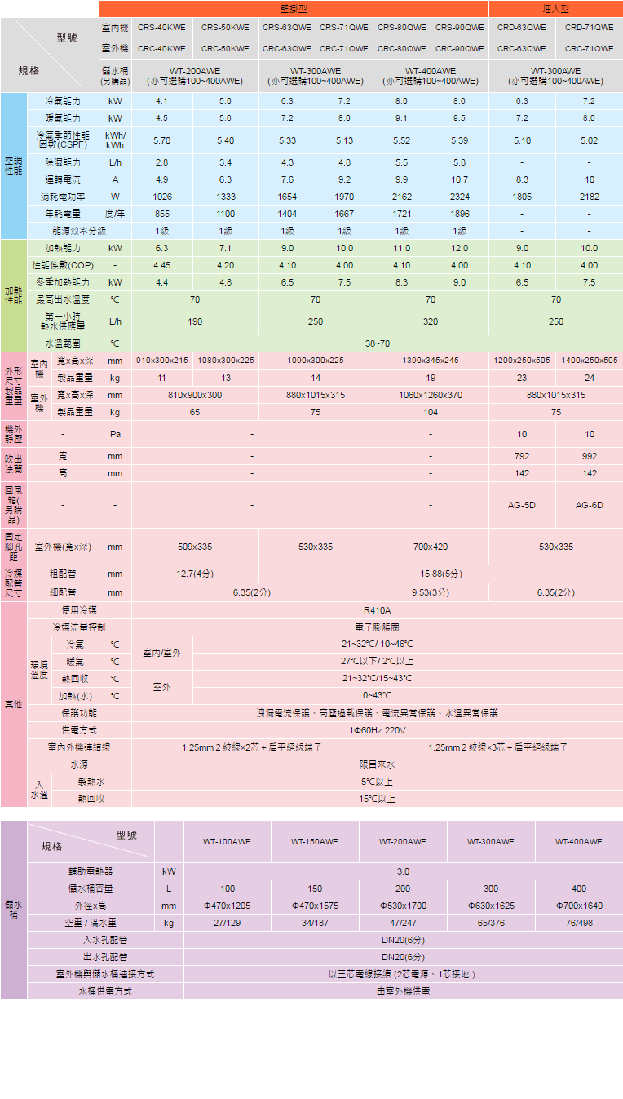
http://www.jci-hitachi.tw/

Slide 9
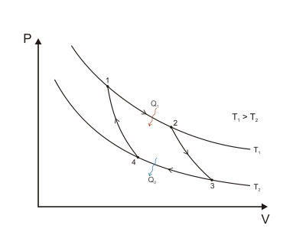
Carnot Cycle
Wiki

Slide 10
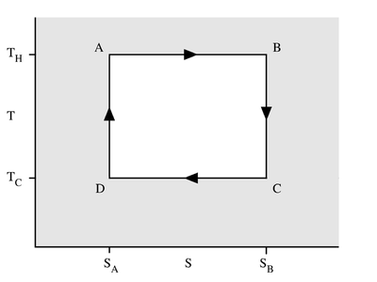
Carnot Cycle
Wiki

Slide 11
Concept of Micro State Vs. Macro State:
Macro state: The properties (such as P, V, T, etc.) can be observed by appropriate tools.
Micro state: such as molecular rotational states, vibrational states, etc. Usually it is hard to measure all the micro states. (It is possible to measure some of the micro states.)
We will be back to this after introducing quantum mechanics.

Slide 12
Calculate the entropy of mixing
Mixing is an irreversible process with
Δs_{mix} = (S₂ − S₁) > 0.
Find another process which is reversible (eg isothermal reversible expansion) and has the same initial and final states as those of the mixing process. Because S is a state function, which does not depend on the path, ΔS = S₂ − S₁ should be the same.
Reversible path
S₂
S₁
Irreversible path

Slide 13
Entropy of mixing of A and B
Write down the initial state:
n_{A} mol of A, P_{A} = P_{i}, V_{A}^{i}, T_{i}
n_{B} mol of B, P_{B} = P_{i}, V_{B}^{i}, T_{i}
Note: before a typical mixing, A and B have the same (P_{i}, T_{i})
The final state:
n_{A} mol of A, P_{A}^{f}, V_{A}^{f} = V_{A}^{i} + V_{B}^{i} = V_{f}, T_{f} = T_{i}
n_{B} mol of B, P_{B}^{f}, V_{B}^{f} = V_{A}^{i} + V_{B}^{i} = V_{f}, T_{f} = T_{i}
Note: Mixing would not change T; after mixing, the partial pressures of A and B (P_{A}^{f} and P_{B}^{f}) change.
We like to learn ONLY the effect of Mixing.

Slide 14
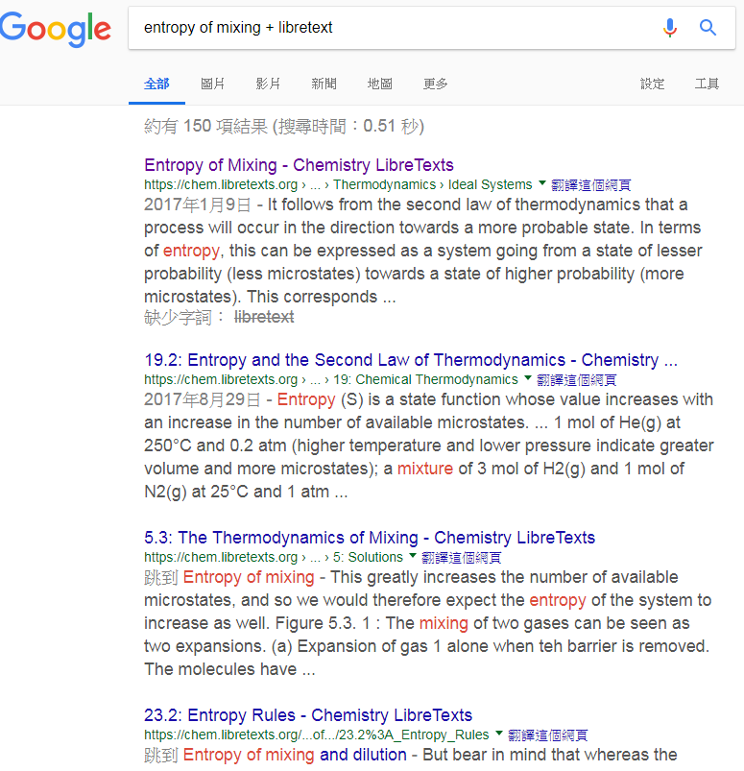

Slide 15
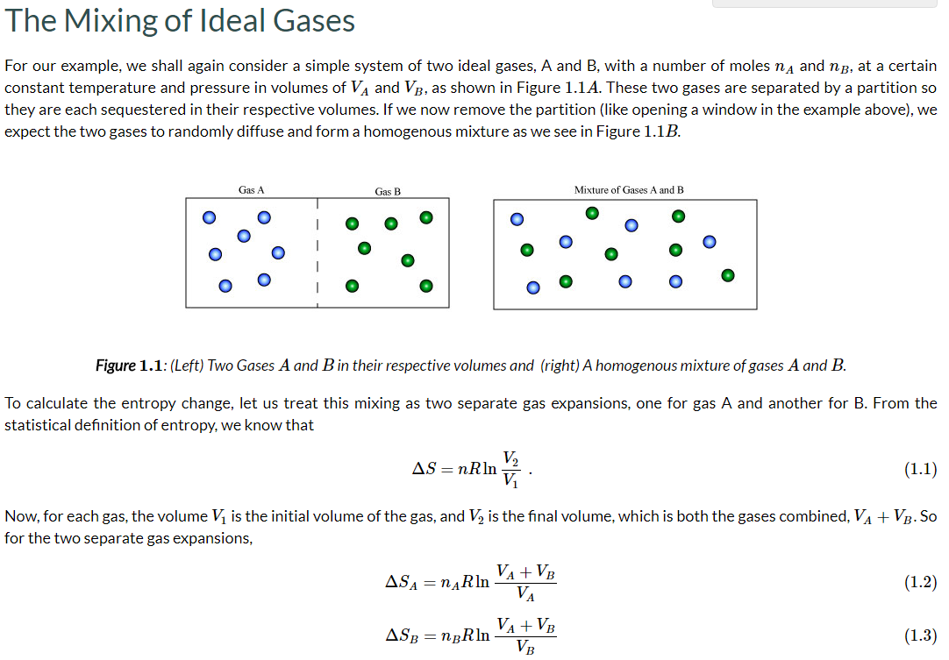


Slide 16
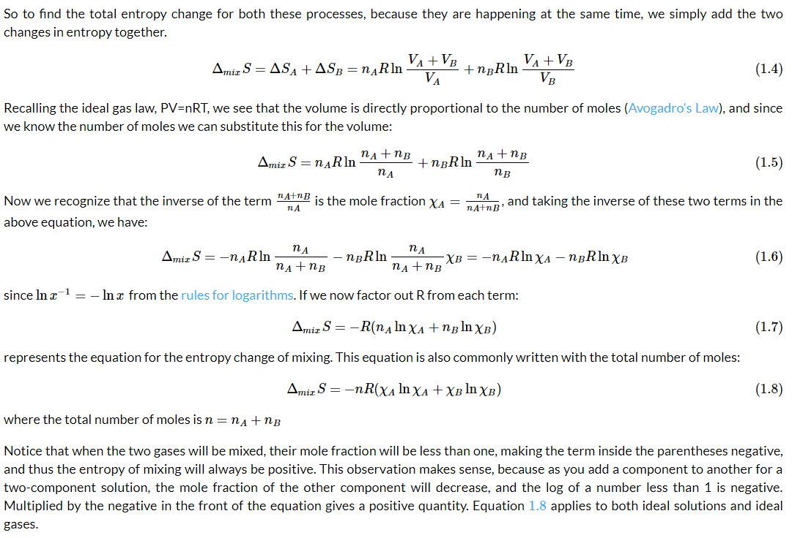

Slide 17
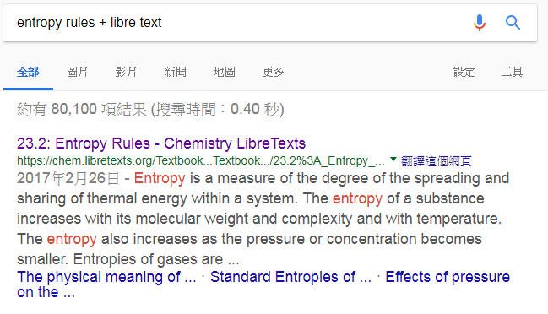
Interesting discussions can be found in
https://chem.libretexts.org/Textbook_Maps/General_Chemistry_Textbook_Maps/Map%3A_Chem1_(Lower)/15%3A_Thermodynamics_of_Chemical_Equilibria/23.2%3A_Entropy_Rules

Slide 18
Useful functions in thermal dynamics
Enthalpy H ≡ U + PV
Gibbs Free Energy G ≡ H − TS
ΔH = ΔU + Δ(PV) = ΔU + PΔV + VΔP
= ΔU + PΔV, at a given P
= Δq
Use H to represent the Heat of reaction at a given P

Slide 19
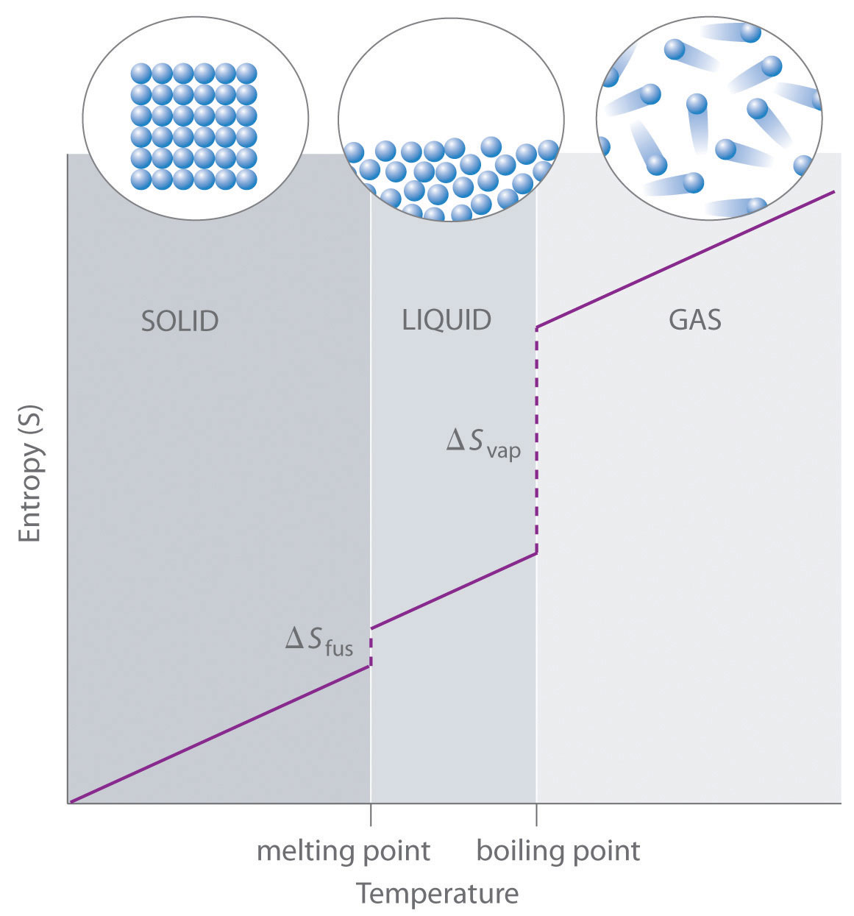
https://chem.libretexts.org/

Slide 20
Equilibrium
At given (P, T), a system tends to go to the minimal G.
Or, G can only become smaller.
Example:
Standard molar enthalpy
H₂O_{(s)} → H₂O_{(l)}
Δ_{s-l}H° = 80cal/g*18g/mol= 1.44 kcal/mol
Δ_{s-l}S° = Δ_{s-l}Q_{rev}° / T_{mp} = 5.275 cal/mol∙K
Δ_{s-l}G° (T = T_{mp}) = Δ_{s-l}H° − T_{mp} Δ_{s-l}S° = 0 only at T_{mp}
What if T ≠ T_{mp}?
Assume Δ_{s-l}H° and Δ_{s-l}S° do not depend on T.

Slide 21
Wiki
Standard states are as follows:
For a gas: the hypothetical state it would have assuming it obeyed the ideal gas equation at a pressure of 1 bar
For a solute present in an ideal solution: a concentration of exactly one mole per liter (1 M) at a pressure of 1 bar
For a pure substance or a solvent in a condensed state (a liquid or a solid): the standard state is the pure liquid or solid under a pressure of 1 bar
For an element: the form in which the element is most stable under 1 bar of pressure. One exception is phosphorus, for which the most stable form at 1 bar is black phosphorus, but white phosphorus is chosen as the standard reference state for zero enthalpy of formation.[2]
1 atm = 1.013 bar

Slide 22
H₂O_{(s)} → H₂O_{(l)}
Δ_{s-l}H° = 80cal/g*18g/mol= 1.44 kcal/mol
Δ_{s-l}S° = Δ_{s-l}Q° / T_{mp} = 5.275 cal/mol∙K
Δ_{s-l}G° = Δ_{s-l}H° − T_{mp} Δ_{s-l}S° = 0
Let the system contains
1−x mol of H₂O_{(s)} and x mol of H₂O_{(l)}
G_{sys} = (1−x)G_{s}° + xG_{l}° = G_{s}° + x(G_{l}° − G_{s}°)
= G_{s}° + xΔ_{s-l}G°
Any x can be the equilibrium state!
No mixing between H₂O_{(s)} and H₂O_{(l)}

Slide 23
H₂O_{(l)} → H₂O_{(g)}
Δ_{l-g}H° = (540 cal/g)(18 g/mol) = 9.72 kcal/mol
Δ_{l-g}S° = Δ_{l-g}Q° / T_{bp} = 26.06 cal/mol∙K
Δ_{l-g}G° = Δ_{l-g}H° − T_{bp} Δ_{l-g}S° = 0
Let the system contains
1−x mol of H₂O_{(l)} and x mol of H₂O_{(g)}
G_{sys} = (1−x)G_{l}° + xG_{g}° = G_{l}° + x(G_{g}° − G_{l}°)
= G_{l}° + xΔ_{l-g}G°
Any x can be the equilibrium state
at T_{bp}.
No mixing between H₂O_{(l)} and H₂O_{(g)}

Slide 24
What does Δ mean in thermal dynamics?
difference or change.
difference between what?
from initial state to final state
between A and B for A → B

Slide 25
G = H − TS, ΔG = ΔH − TΔS , at given T
Equilibrium state tends to have lower H but higher S
Or simply lower G at given P, T.
Water vapor has higher enthalpy H and
also higher entropy S.
The entropy term is more important at higher T.

Slide 26
What happens when there are H₂O_{(l)}, H₂O_{(g)} and air?
H₂O_{(l)} → H₂O_{(g)}, T < T_{bp} P_{vapor} < 1 atm
Bigger V has larger S, lower G

Slide 27
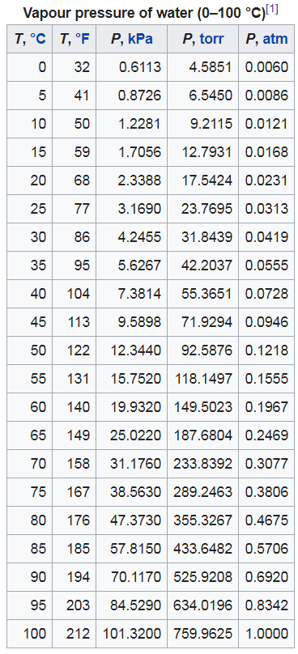
7% per degree near 300 K
This 7% rule is useful & important.
Wiki

Slide 28
Why ± 2 ºC
±2℃ / 正負2度C
由孫大偉、陳文茜監製的紀錄片，是第一部記錄台灣氣候變遷的紀錄片。 台灣必須面對的真相是，台灣人口密度過高、土地侵蝕率高等，恐怕是氣候變遷下「全世界的第一批難民」。

Slide 29
Per 1 mol of A
Per 1 mol of B
At Equilibrium, molar G_{A} = G_{B}, otherwise the Eq will move.
Thus we have K_{eq}.
Same idea can be visualized in the next page.

Slide 30
Homogeneous RXN versus Inhomogeneous RXN
Consider Entropy of Mixing
One example for A_{(g)} → B_{(g)}, ΔGº = 2.5 kJ/mol is shown below. 1−x mol of A + x mol of B
A
1−x
B
x
A
1−x
B
x
Homogeneously mixed

Slide 31
The minimum of G_{sys} corresponds to the Equilibrium state.
Standard concentration
unitless
Eq

Slide 32
Appendix I:
Several commonly studied thermodynamic processes : Adiabatic process: q = 0
Isenthalpic process: enthalpy H = constant
Isentropic process: a reversible adiabatic process,
(dq_{rev} = 0) occurs at a constant entropy
Isobaric process: occurs at constant pressure
Isochoric process: occurs at constant volume (also called isometric/isovolumetric)
Isothermal process: occurs at a constant temperature
Wiki

Slide 33
Appendix II:
Effect of Temperature for Δ_{s-l}H° and Δ_{s-l}S°
T
water @T_{mp}
ΔH_{mp}
T
ice @T_{mp}

Slide 34
for pure water & for pure ice
T
water @T_{mp}
ΔS_{mp}
T
ice @T_{mp}

Slide 35
Mostly cancelled if T≈T_{mp}
H₂O_{(s)} → H₂O_{(l)}
Energy/(cal mol⁻¹)
T/K

Slide 36
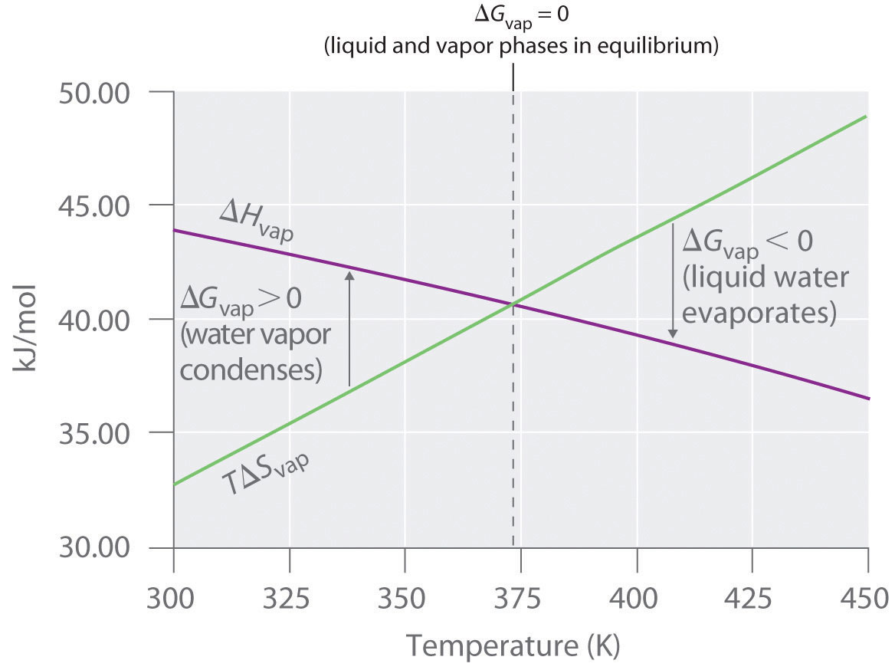
https://chem.libretexts.org

